Slide 1
LAB - 10

Slide 2
Problem Statement
You are working at Bob’s Retail Store. The store sells books, DVDs, and consulting services. All items incur a 6% sales tax charge. Information associated to each thing sold is shown below using examples: Book – Under the Dome by Stephen King [Retail Cost: $9.95]
DVD – Casablanca, Drama Section [Retail Cost: $14.99 + $1.00 handling fee]
Note: The handling fee is the same for all DVDs, but may change in the future
Consulting Service – DVD Repair [Retail Cost: $100.00 per hour]

Slide 3
Using solid OO design principles, simulate the purchase of the three things listed above by creating the appropriate data definition and implementation classes.
Start with the given code. Copy and paste each class into a separate file in your IDE. Then fill in ONLY
the parts where comments suggest code is needed. Do not create/edit code outside of the comment blocks. Your code must compile. If your code does not compile, a grade of 0 will be earned. No exceptions! Upload your completed .java files. Make sure you upload the .java file and not the .class file.

Slide 4
Product Class
In this file, do the following things:
Modify the class so that a Product object cannot be created. Instead, only subclass objects of Product can be created
Modify the class so that all Product objects must use the Sellable interface

Slide 5
Sellable Class
No changes are required in this class

Slide 6
Book Class
In this file, do the following things:
Modify the class so that it inherits from Product
Create a constructor that takes in a book title and book cost

Slide 7
DVD Class
In this file, do the following things:
Modify the class so that it inherits from Product
Create a constructor that takes in a DVD title, DVD cost, and DVD genre
Override the getCost() method by adding the DVD handling fee to the cost calculated for a Product

Slide 8
Consulting Service Class
In this file, do the following things:
Modify the class so that all Consulting Service objects must use the Sellable interface
Create a constructor that takes in a consulting service name, consulting service cost per hour, and a consulting service number of hours
Override the getCost() method and return the result of multiplying the consulting service cost per hour by the consulting service number of hours
Modify the class so that it inherits from Product

Slide 9
Purchase Class
Follow the instructions and edit inside the comments block.
Hardcode the values by considering the values that are given in the question.
1. Book (Name: Under the Dome by Stephen King and Retail Cost: $9.95)
2. DVD (Name: Casablanca, Drama Section and Retail Cost: $14.99)
3. Consulting Service(Name: DVD Repair and Retail Cost : $100.00 per hour)

Slide 10
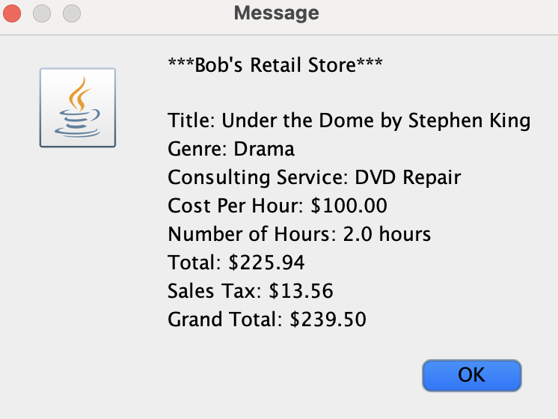
Sample Output

